Slide 1

Draw a bounding box around this point of interest.

Slide 2

Identify this point of interest!

Slide 3

Crowdsourcing methods are widely used in industry and academia; across different domains and disciplines
Conducting user studies and experiments with human subjects

Slide 4

Configuring Study Parameters
Incentives
Task reward scheme
Task completion time
Task description
…
Notes:
Many important configuration parameters of a crowdsourcing study are not known before the campaign is launched. These parameters are difficult to estimate.

Slide 5
Configuring Study Parameters
Incentives
Task reward scheme
Task completion time
Task description
…
“Crowd pilot studies” are used to estimate and calibrate important study parameters.
Notes:
For this reason, researchers often conduct small-scale pilot studies. Pilot studies help to estimate the parameters of the larger crowdsourcing campaign. Pilot studies are a vital part of crowdsourcing research and researchers often launch one or several small-scale studies before deploying the main study.

Slide 6



The State of Pilot Study Reporting in Crowdsourcing: A Reflection on Best Practices and Guidelines
Jonas Oppenlaender, Tahir Abbas, Ujwal Gadiraju

Slide 7
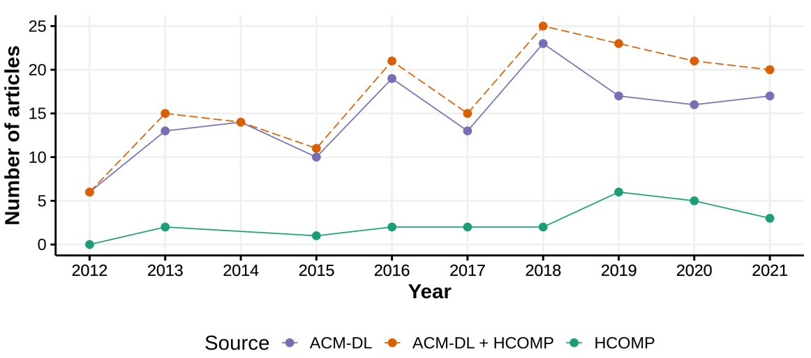
Crowd Pilot Studies Are Common

Slide 8
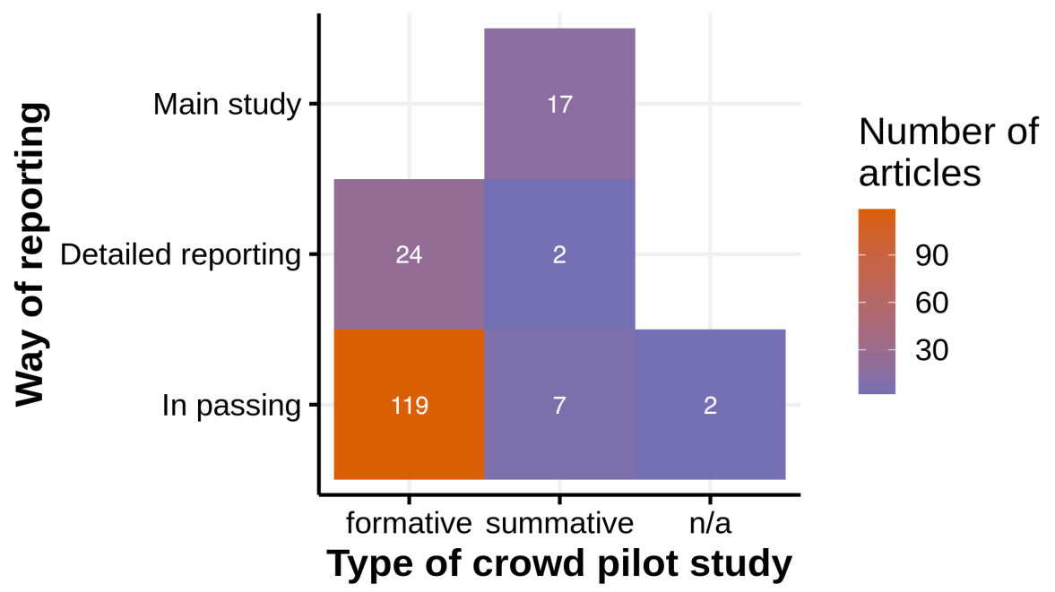
Crowd Pilot Studies: Often Ad-hoc and Under-reported!
Notes:
Crowd pilot studies are under-reported and often conducted in an ad-hoc manner. It is not uncommon for authors to brush over a pilot study by stating “parameters were estimated in a pilot study” — without providing more details. Note that crowd pilot studies often concern key aspects of an experiment. Crowd pilot studies are often conducted for formative purposes (as shown in this figure). Yet, authors do not conduct pilot studies with the same rigor as their main studies. It is not uncommon for authors to make important design decisions “based on a pilot study”, without providing any details. This is concerning for multiple reasons.

Slide 9

Why is under-reporting crowd pilot studies undesirable?
Promotes a lack of rigor
In conflict with good scientific practice and open science
Hinders future reproduction and replication
E.g., ‘iterated extensively in pilot studies with crowd workers to strike a balance between simplicity (avoid complex or numerous instructions) and effectiveness (make the layout better)’
Notes:
2. Opaque reporting of crowd pilot studies is in conflict with good scientific practice and one of the fundamental tenets of open science — to make knowledge transparent and accessible.
3. A lack of transparency on key design parameters of a crowdsourcing campaign hinders future reproduction and replication. For instance, readers can learn little from reading that authors ‘iterated extensively in pilot studies with crowd workers to strike a balance between simplicity (avoid complex or numerous instructions) and effectiveness (make the layout better)’ — a quote from the literature we reviewed. Based on such a description of a crowd pilot study, researchers or practitioners, who may want to learn more about how to achieve a balance between simplicity and effectiveness for their own crowdsourcing study, will arguably be left guessing.

Slide 10
Why is under-reporting crowd pilot studies undesirable?
Promotes a lack of rigor
In conflict with good scientific practice and open science
Hinders future reproduction and replication
Crowd pilot studies can be flawed
Crowd workers’ perspective
Systematic underpayment of workers
Unattractive to workers
Novice workers may abandon crowd work
Notes:
4. Crowd pilot studies are just as likely to be flawed as any other (main) studies which are expected to withstand the scrutiny of peer review as a means to ensure quality, reliability, good practice, and a sound scientific method. Flaws in crowd pilot studies can go unnoticed if they are not reported in sufficient detail.
5. Another reason why more transparency around pilot studies is warranted is motivated by the crowd workers’ perspective. It is not uncommon for researchers to underestimate the price of a task. Designing an efficient task takes time, and due to this sunk cost, task designers can be biased and will have a hard time to accurately estimate the reward of a crowdsourced task. Yet in our literature review, we found it is not common to make up for these estimation errors (e.g., with bonus payments to workers). Pilot studies, while small-scale, are common — every crowdsourcing study will, typically, estimate rewards with a crowd pilot study. This may contribute to the systematic underpayment of workers (Read more about the invisible labor the characterizes crowd work in Mary Gray and Sid Suri’s book called ”Ghost Work”). Further, crowd pilot studies are relatively unattractive to many workers because of their small-scale and inaccurate payment. Experienced workers will likely want to avoid crowd pilot studies. That leaves crowd pilot studies to inexperienced workers, who are often forced by the platform to complete a large number of tasks before they can work on more lucrative tasks in larger batches. Crowd pilot studies, due to this, systemically affect novices who may abandon crowdsourced work if not treated well.

Slide 11
Why are crowd pilot studies under-reported?
Availability heuristic
Reviewing practices, standards, policies
Notes:
1.A psychological model explaining why pilot studies are not being reported more often in the scholarly literature is the availability heuristic. The more researchers report crowd pilot studies in an opaque way, the more frequently other researchers will observe such reporting. Practitioners and researchers in the communities, therefore, may receive signals from the community that the details of the pilot study are not important.
2.Another signal is sent by reviewers and editors who often accept papers with sparse details on pilot studies. Therefore, researchers and practitioners may not consider details about pilot studies as important or useful for their own work, and may not place importance on reporting their own pilot studies.

Slide 12

The State of Crowd Pilot Study Reporting
RQ1: Why are crowd pilot studies typically conducted? RQ2: How are crowd pilot studies typically reported? RQ3: What do crowd pilot studies report? RQ4: What makes a “good” crowd pilot study? RQ5: What are the factors that promote or obstruct reporting crowd pilot studies? RQ6: How can crowd pilot studies be facilitated with platform-specific features?
Notes:
Our work presents a literature review (N=171) on the state of crowd pilot study reporting in crowdsourcing research. Our research questions are presented here. To the best of our knowledge, our work is the first to provide a systematic investigation on the state of practice of crowd pilot study reporting in the crowdsourcing and HCI literature.

Slide 13

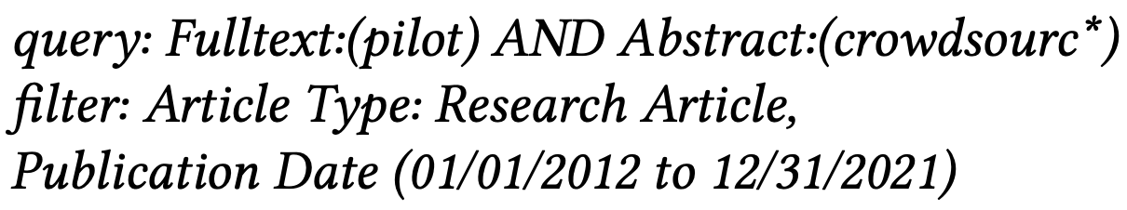
Method: Systematic Literature Review
Pilot study ➔ any small or large-scale experiment/study conducted to inform the design of a prototype, validate a proof of concept, or for other formative or summative reasons
Crowd ➔ exclusive focus on pilot studies conducted with external crowds
10 years (2012–2021): HCOMP; ACM DL

Slide 14
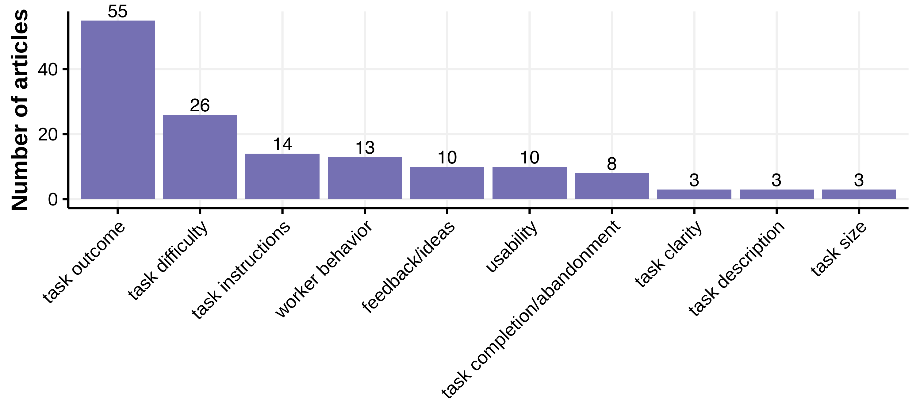
Task Design Reasons for Conducting Crowd Pilot Studies

Slide 15
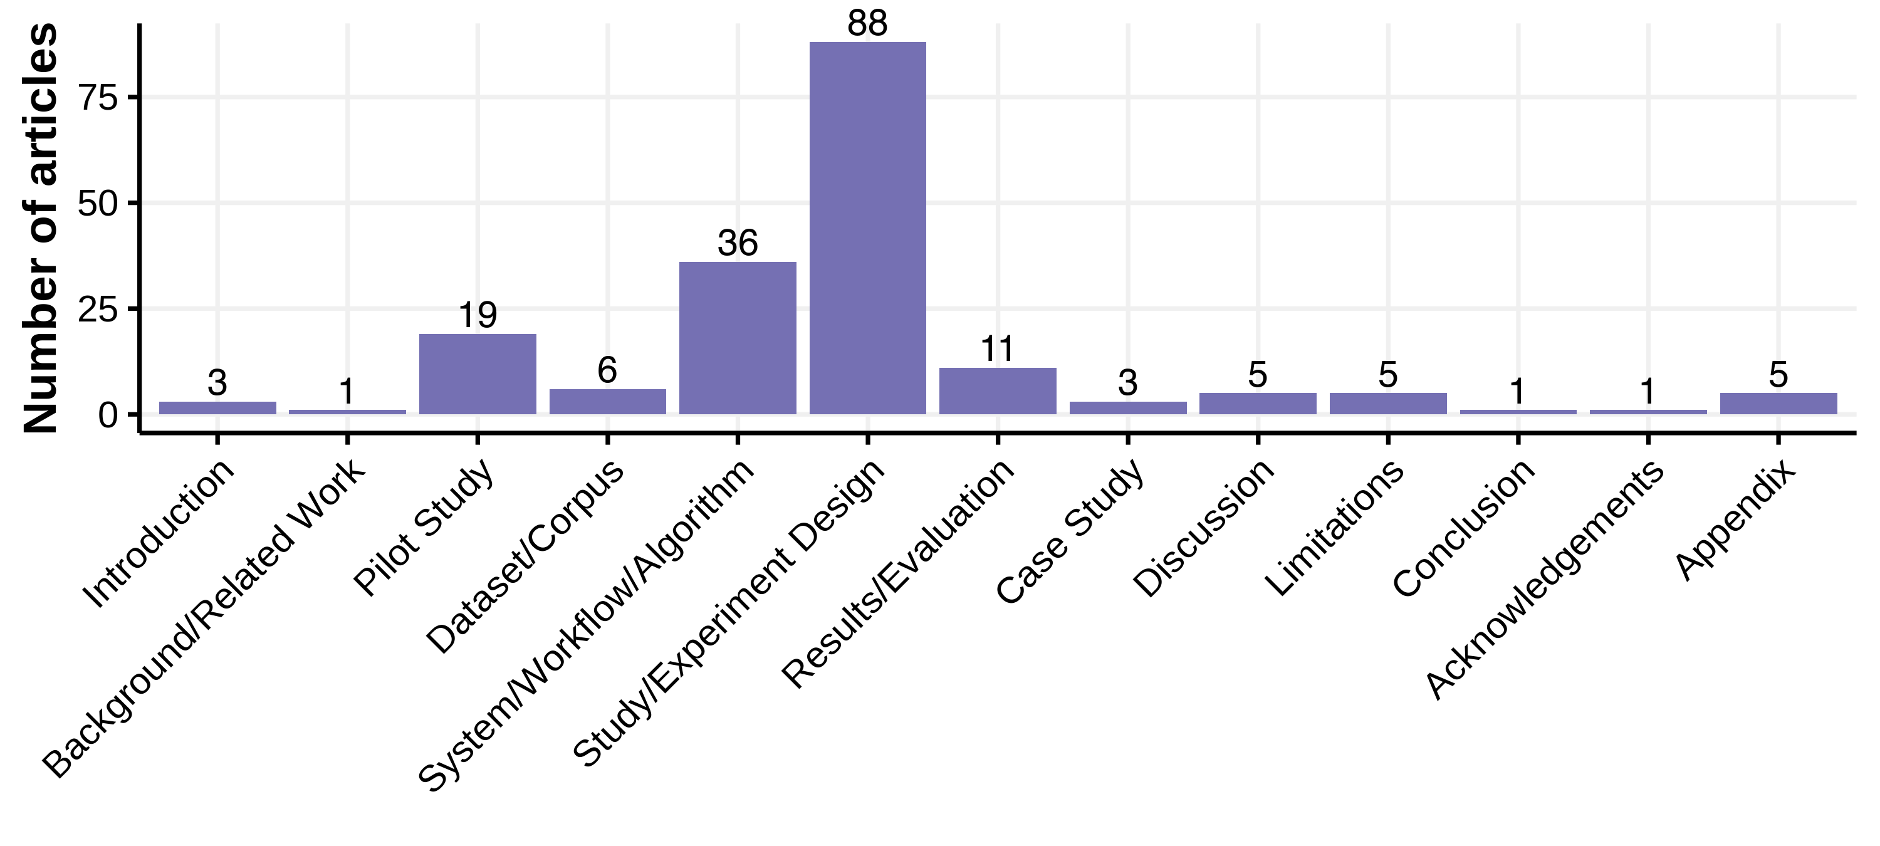
How Are Crowd Pilot Studies Typically Reported? → Sections

Slide 16
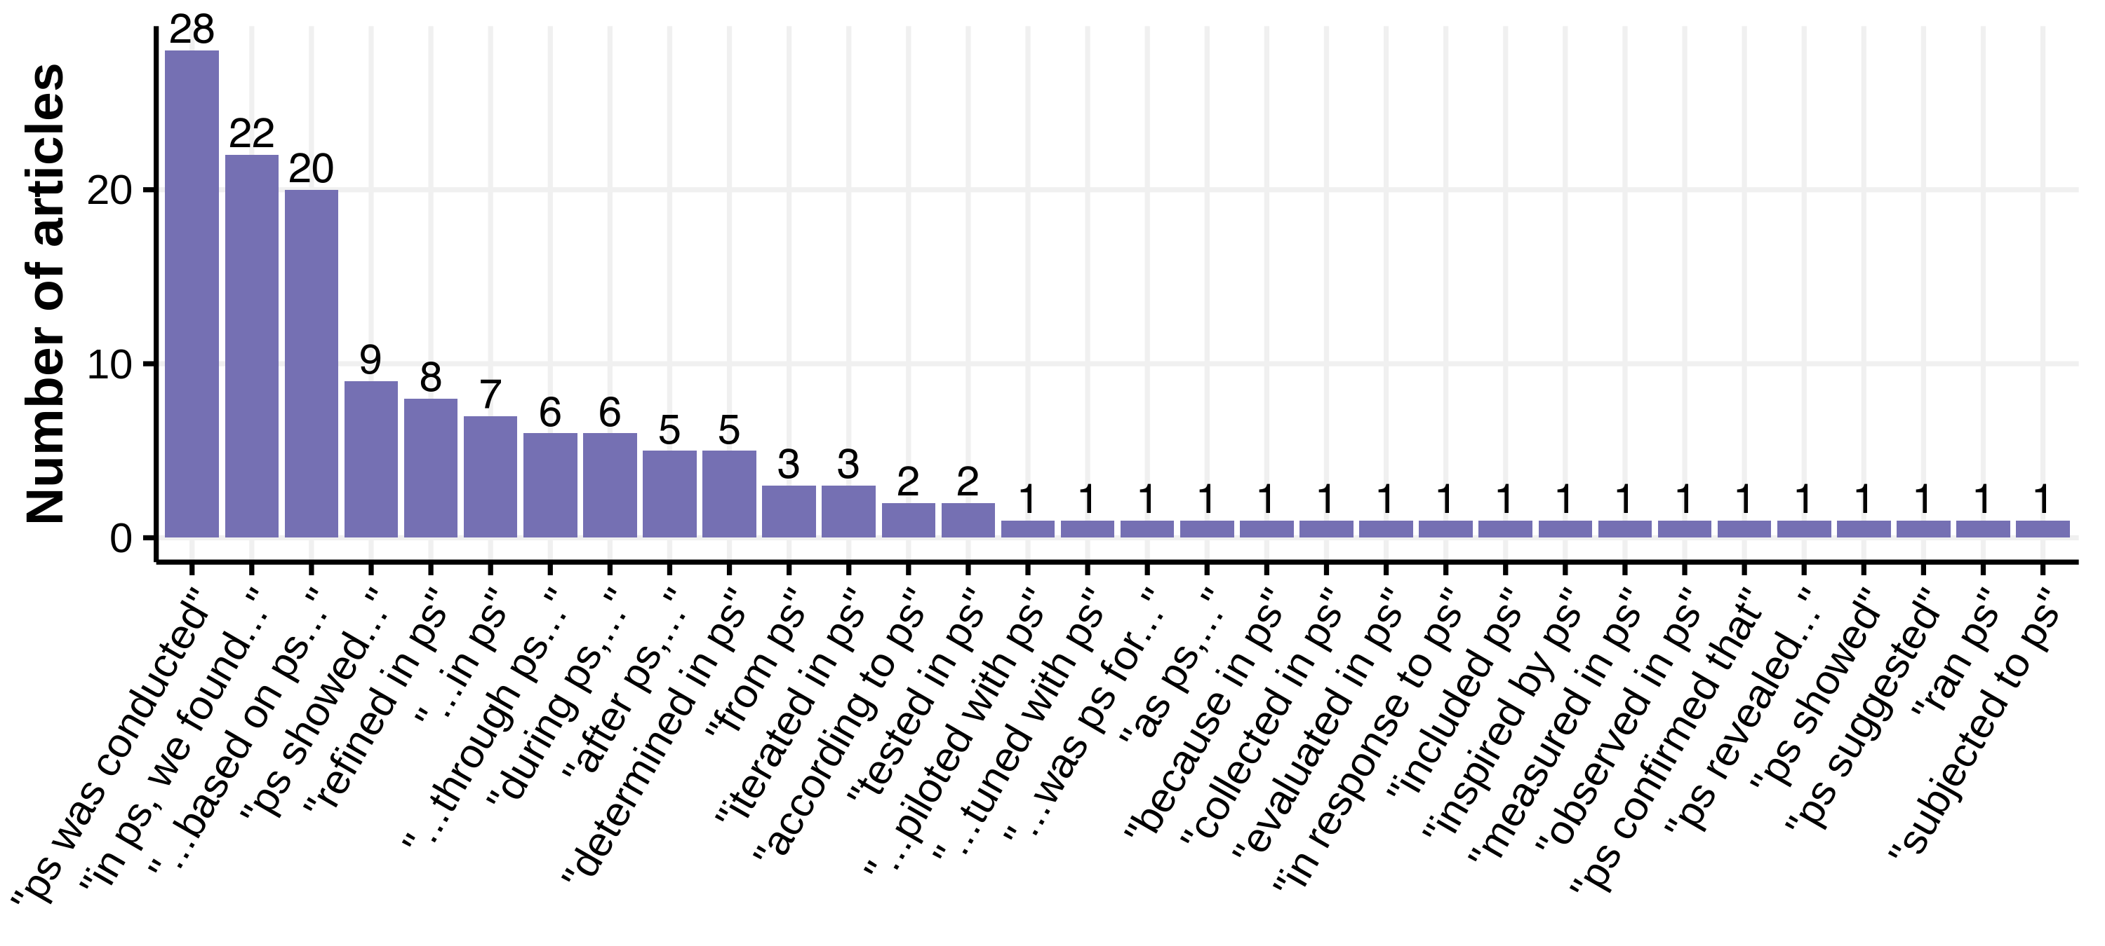
How Are Crowd Pilot Studies Typically Reported? → Phrasing

Slide 17
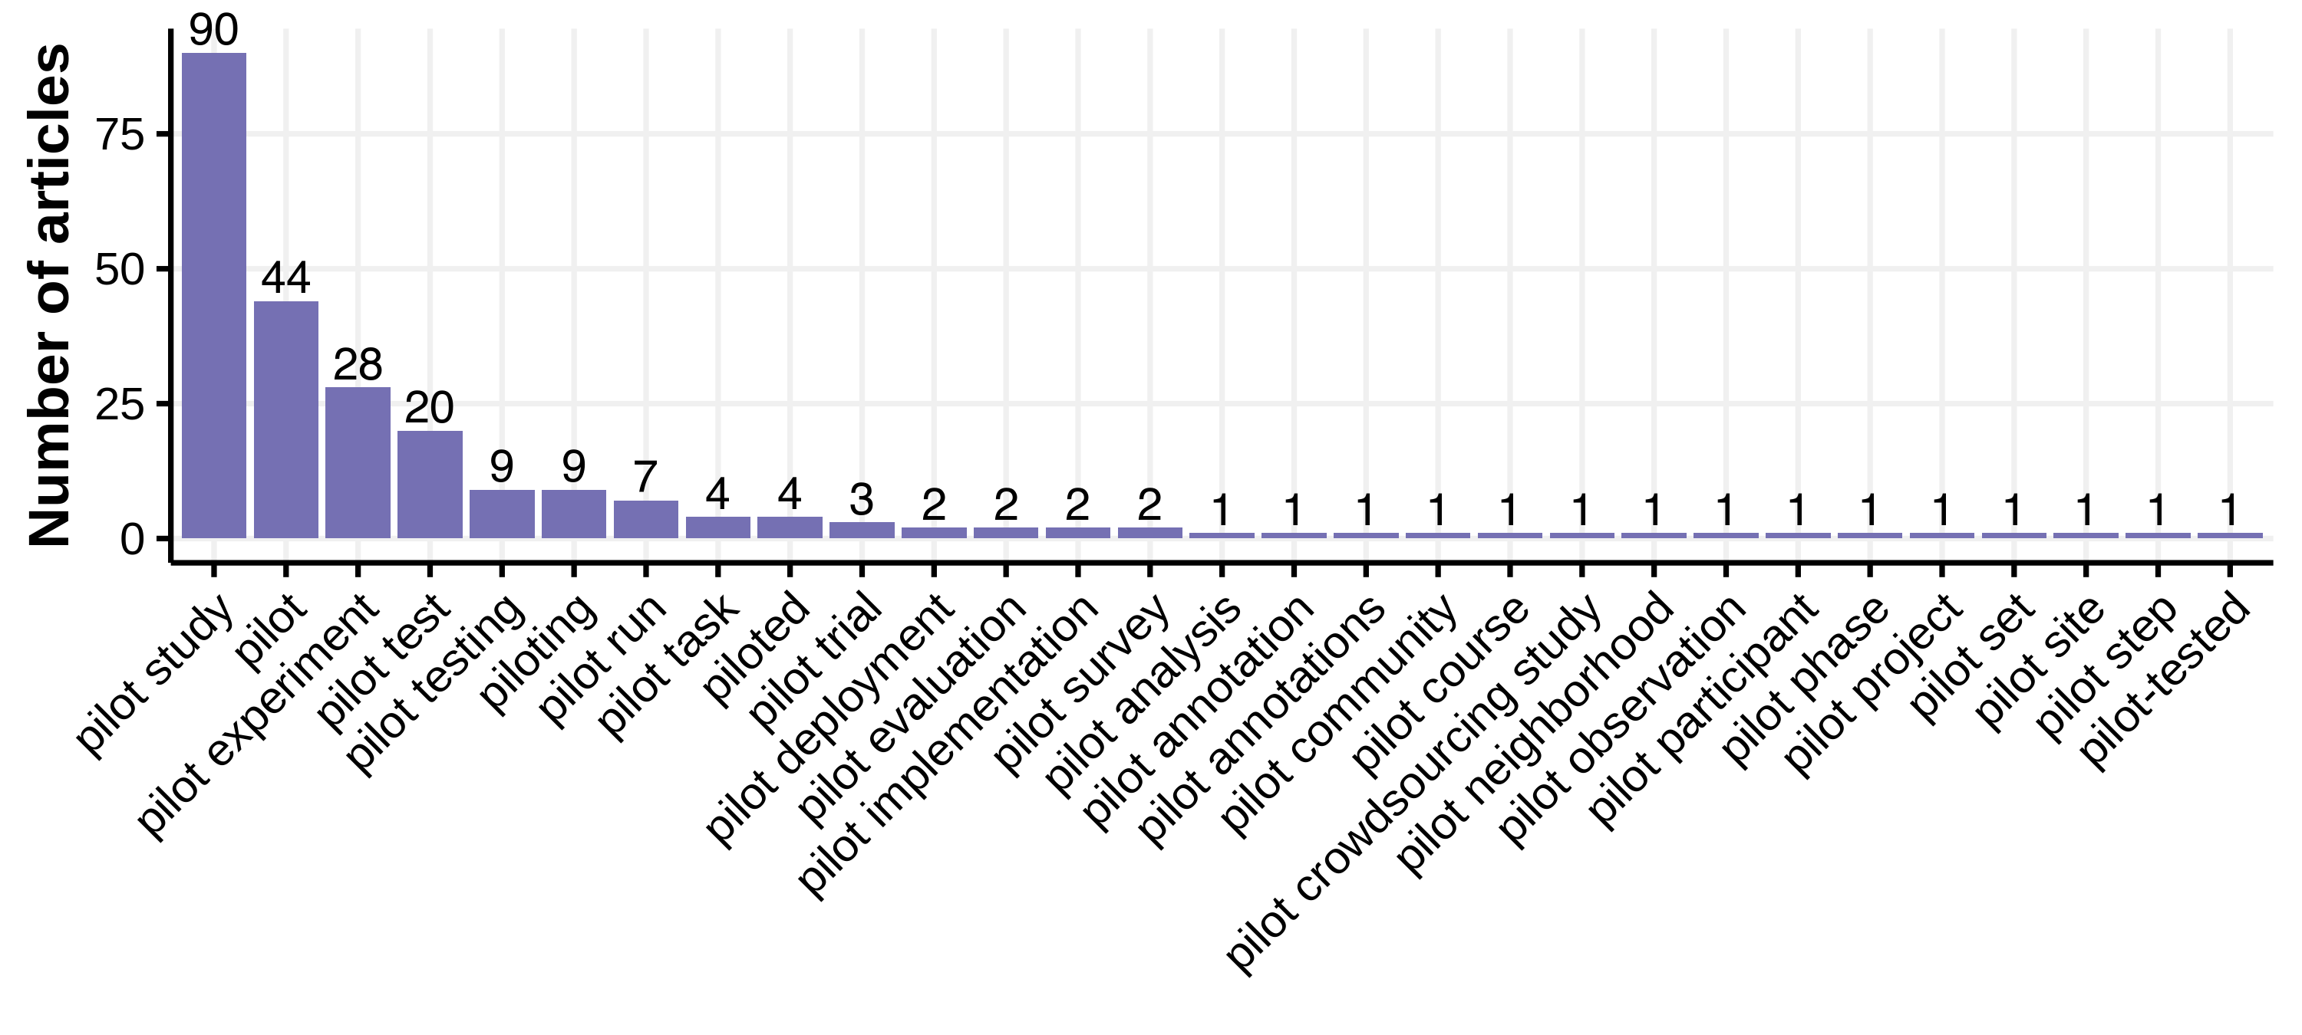
How Are Crowd Pilot Studies Typically Reported? → Terms

Slide 18
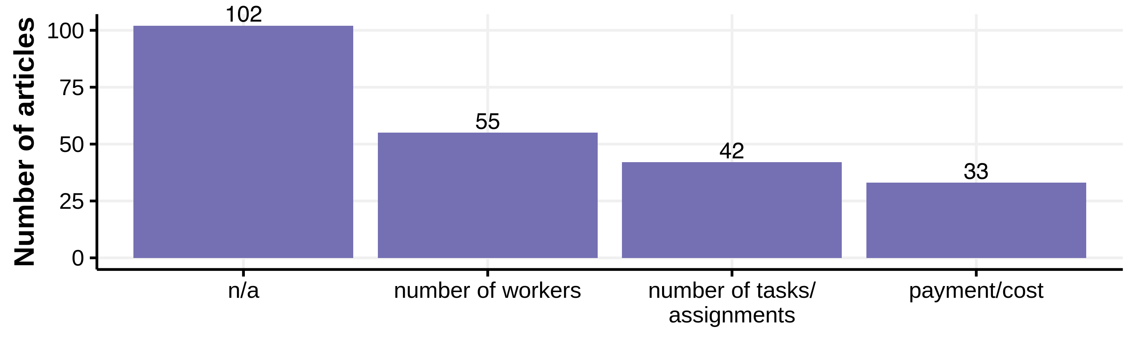
What is Reported?

Slide 19

Guidelines for Reporting Crowd Pilot Studies
Transparency: reasons for conducting the crowd pilot studies
Inform crowd workers about the pilot
Report number of pilot studies and their extent
Clearly identify the participants
Report the key attributes of each crowd pilot study

Slide 20
Key Attributes of Crowd Pilot Studies
number of participating crowd workers
number of tasks (or assignments to workers)
payment per task
participation constraints enforced (including platform settings)
the type of crowd or crowdsourcing platform

Slide 21

Reporting at the minimum!
Notes:
Inspired by scientific reporting guidelines, such as guidelines by the American Psychological Association [12], and based on the above recommendations while also considering the trade-offs

Slide 22

The State of Crowd Pilot Study Reporting
RQ1: Why are crowd pilot studies typically conducted? RQ2: How are crowd pilot studies typically reported? RQ3: What do crowd pilot studies report? RQ4: What makes a “good” crowd pilot study? RQ5: What are the factors that promote or obstruct reporting crowd pilot studies? RQ6: How can crowd pilot studies be facilitated with platform-specific features?
Read our paper to
find out more!

Slide 23






U.K.Gadiraju@tudelft.nl
https://ujwalgadiraju.com
@UJLAW

Slide 24
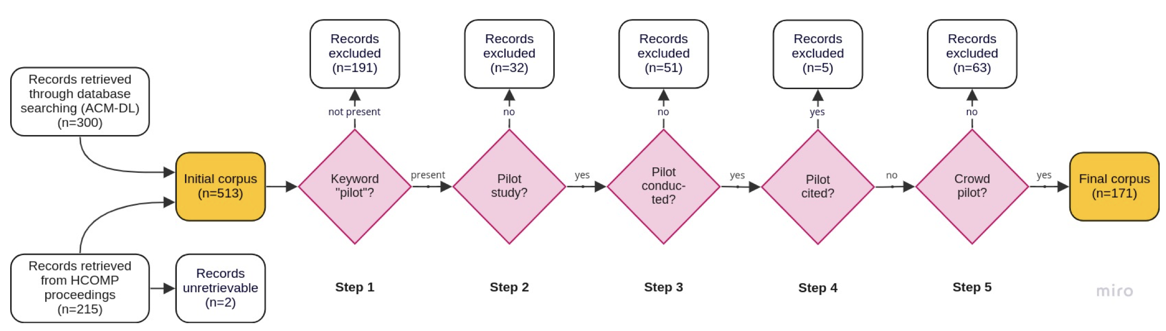
Corpus Screening Procedure

Slide 25
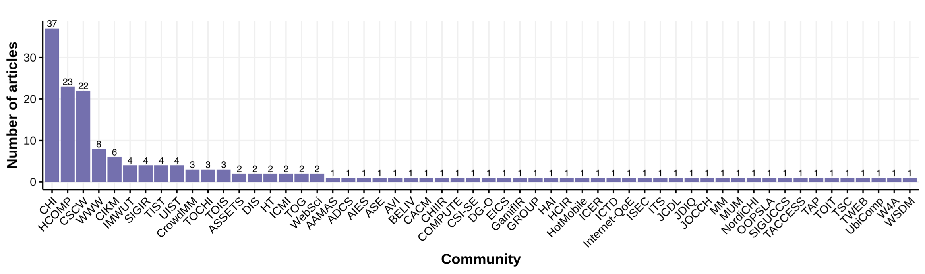
Conference Venues & Journals

Slide 26

What makes a “good” pilot study?
Mimicking/mirroring the main experiment
Exploration and experimentation
Validating the feasibility of a study
Accurate estimation of campaign parameters

